Slide 1
What is Starfish?
November 2018

Slide 2
Objectives
By the end of this session, you will be able to…
Explain the purpose of Starfish
Log in to Starfish

Slide 3
Key Points
Starfish is a tool that helps you reach your educational goals.
Starfish connects you to your Success Network, which includes your instructors, advisors, and other support resources at Pierce College.
You can log into Starfish directly using your WiFi/Papercut (printing) login.

Slide 4
What is Starfish?
Starfish is a web-based software tool designed to assist you in achieving your educational goals.
In Fall 2018, Pierce College is gathering feedback about this new tool by introducing it to a pilot group of students and employees.
You can help us make Starfish better for everyone!

Slide 5
Why use Starfish?
Starfish helps students in multiple ways, including…
  Connecting you with a network that includes faculty and staff dedicated to your success.
  Enabling you to schedule appointments with faculty, advisors, and other resource staff online.

Slide 6
Why use Starfish?
More helpful features are coming soon, including…
  Course registration and degree planning.
  The ability to monitor your progress toward your educational goals.

Slide 7
What is a Success Network?
Your Success Network includes your instructors, your advisor, and additional resources relevant to you.
Starfish lets your Success Network know when and how to best provide support, like answering financial aid/funding questions, addressing basic needs issues (transportation/housing/food security), and providing ongoing transfer and career pathways advice.
The goal with Starfish is to get you the right resources when you need them!

Slide 8
How is Starfish unique?
You have several online tools for success, including Canvas and your Pierce College email address.
Starfish is unique because it allows you to quickly connect with your campus resources, in addition to your current faculty for each term.

Slide 9




Tools for Success
Starfish | MyPierce Portal | Canvas | Pierce Email
Your connection to your Success Network, including instructors, advisors, and staff, as well as additional resources and services | Your portal to registration, financial aid, transcripts, and other essential functions of your student record | Your online classroom where you connect with your classmates and instructors this quarter | Your official means of communication with Pierce College, where you send and receive communications about college-related matters

Slide 10
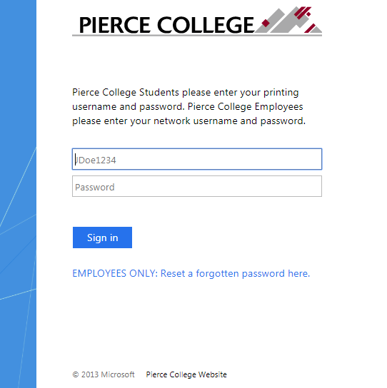
How to Log In
Go to the Starfish URL:
https://pierce.starfishsolutions.com/starfish-ops
Use your WiFi/Papercut (printing) login.

Slide 11
Your Login Credentials
User name: jgonzales6789
First Initial + Last Name + Last Four of Student ID
Password: PCD!19951108
PCD! + YYYY + MM + DD
This is the password for someone born November 8, 1995.
This is the same login that you use for campus WiFi and Papercut printing.

Slide 12
That’s it!
Now that you’ve logged in, you should update your profile.
See the next session for details about how to update your profile.

Slide 13
Need help?
If you’re getting frustrated, or if Starfish isn’t working the way you expected, please email StarfishTeam@pierce.ctc.edu.
You can also contact
Tami Jacobs
Dean of Student Success & Starfish Implementation Lead
StarfishTeam@pierce.ctc.edu
(253) 964-6581

