Slide 1
Updating Your Profile
November 2018

Slide 2
Objectives
By the end of this session, you will be able to…
Update your profile in Starfish, including adding an additional email address for alerts and setting your preferences

Slide 3
Key Points
Emails and alerts from Starfish will be sent to your Pierce College email address.
You can add an additional email address in your profile.
Information in your profile is automatically loaded from your student record. If information is incorrect, visit your MyPierce Portal or a Registration Office.

Slide 4
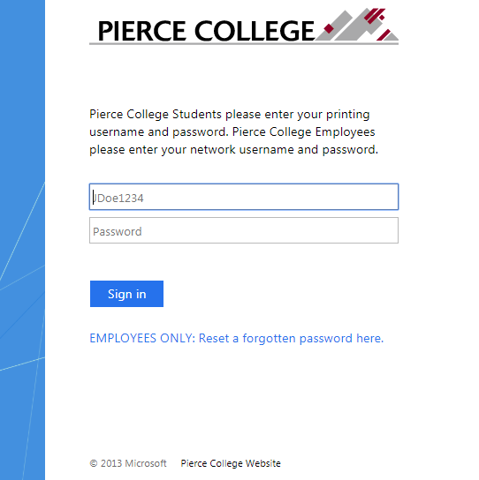
How to Log In
Go to the Starfish URL:
https://pierce.starfishsolutions.com/starfish-ops
Use your WiFi/Papercut (printing) login.

Slide 5
Your Login Credentials
User name: jgonzales6789
First Initial + Last Name + Last Four of Student ID
Password: PCD!19951108
PCD! + YYYY + MM + DD
This is the password for someone born November 8, 1995.
This is the same login that you use for campus WiFi and Papercut printing.

Slide 6
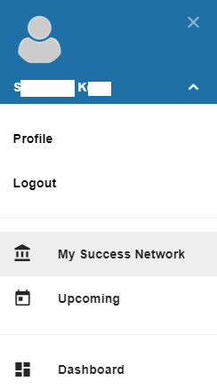
To Access Your Profile
From the main menu, click the white arrow next to your name.
Then select Profile.

Slide 7
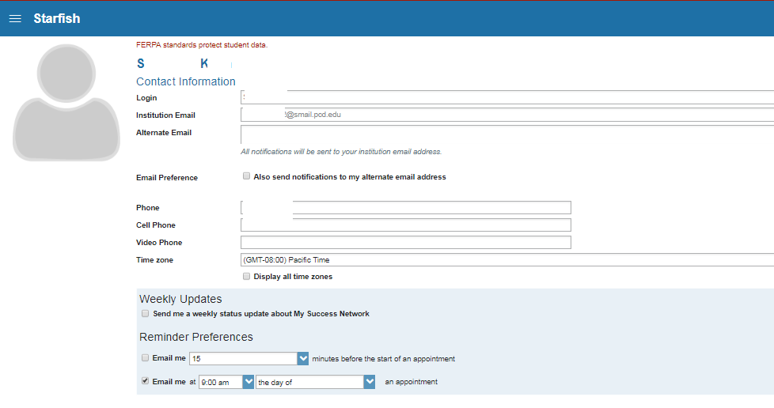
If you want messages from Starfish to go to an additional email address, enter it here.

Slide 8
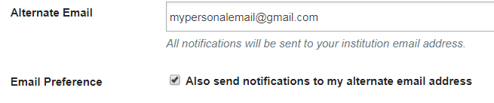
Starfish messages may contain private or sensitive information, so be sure to enter an email address that only you can access.

Slide 9
If your phone number is incorrect, visit your MyPierce Portal or a Registration Office to update it.

Slide 10
You can control how often you receive updates and reminders via email.

Slide 11

If you’re happy with your changes, click Submit in the lower right-hand corner.

Slide 12
Need help?
If you’re getting frustrated, or if Starfish isn’t working the way you expected, please email StarfishTeam@pierce.ctc.edu.
You can also contact
Tami Jacobs
Dean of Student Success & Starfish Implementation Lead
StarfishTeam@pierce.ctc.edu
(253) 964-6581

