Slide 1
Making Appointments
November 2018

Slide 2
Objectives
By the end of this session, you will be able to…
Make appointments online with your Connections
Use your Success Network

Slide 3
Key Points
You can use Starfish to make appointments online, provided your Connections have enabled online scheduling.
If online scheduling is not available, you can still contact instructors, staff, and other resources through email or phone calls.

Slide 4
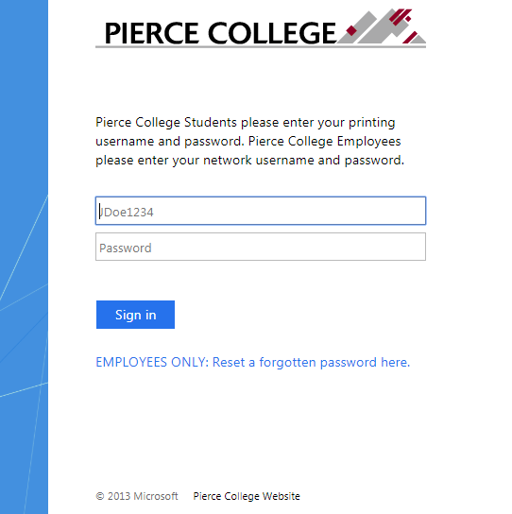
How to Log In
Go to the Starfish URL:
https://pierce.starfishsolutions.com/starfish-ops
Use your WiFi/Papercut (printing) login.

Slide 5
Your Login Credentials
User name: jgonzales6789
First Initial + Last Name + Last Four of Student ID
Password: PCD!19951108
PCD! + YYYY + MM + DD
This is the password for someone born November 8, 1995.
This is the same login that you use for campus WiFi and Papercut printing.

Slide 6
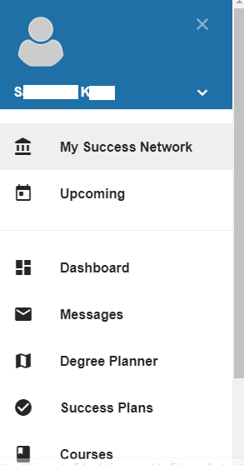
Your Success Network
Access your Success Network from the main menu, under your name.

Slide 7
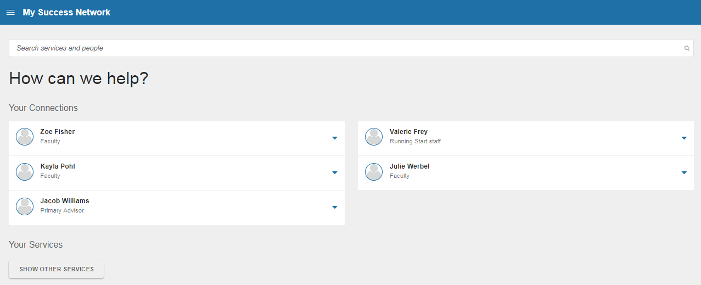
Your Success Network
Your Connections include faculty, advisors, and staff who are connected to you.

Slide 8
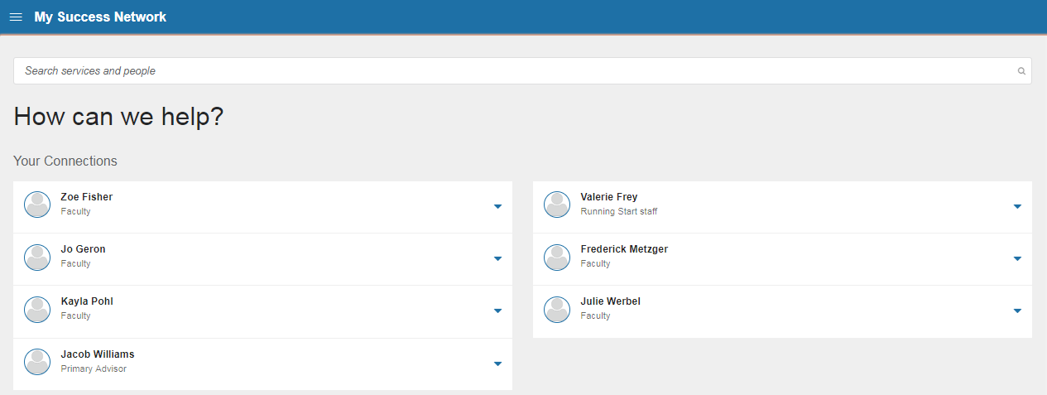
Your may notice your Connections change! This is normal.
For example, your Connections always show your instructors from the current quarter. Once you register for the next quarter, it will show those instructors as well.

Slide 9
Your Success Network
You can search for people in your Network here. In the future you will also be able to search for services.

Slide 10
Your Success Network
Coming soon! You’ll be able to find other services and resources available at Pierce.

Slide 11
How to Make Appointments
Use the blue arrow next to the Connection’s name to view their contact information and schedule.

Slide 12
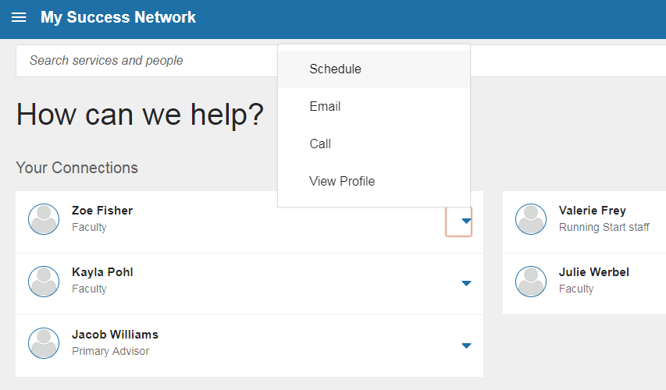
If Schedule appears as an option in the Connection’s menu, it means that online appointment scheduling is available.

Slide 13
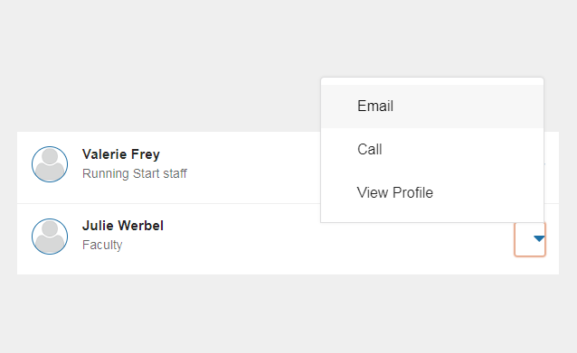
If Schedule is not an option in the Connection’s menu, it means that your Connection has not enabled online scheduling.

Slide 14
You can view your Connection’s profile to see their contact information, or use the Email/Call options within the menu.

Slide 15
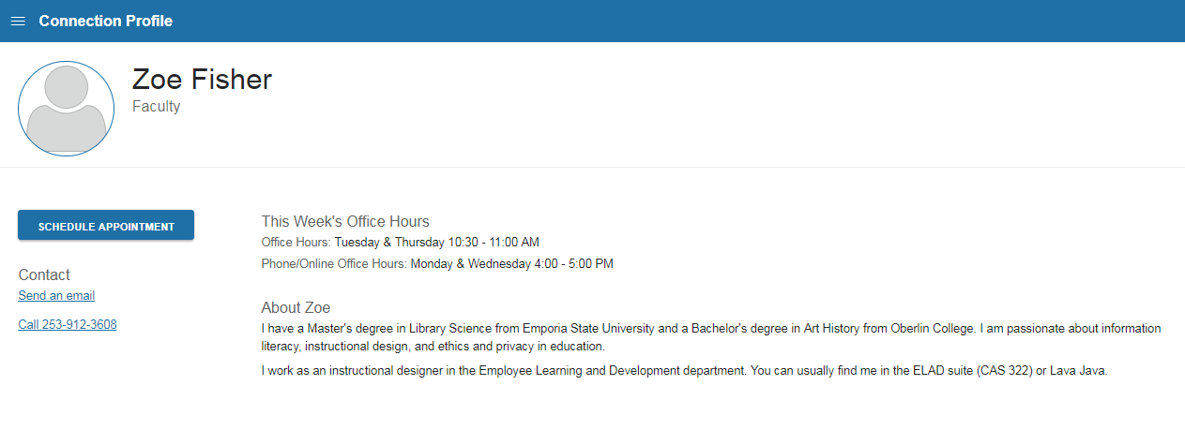
Your Connection’s profile will include their email address and phone number. It may also include their office hours and a biography.

Slide 16
To make an appointment, click Schedule from this menu or “Schedule Appointment” from the Connection’s profile page.

Slide 17
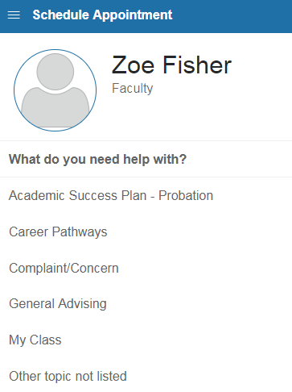
To begin, select a reason for the appointment.

Slide 18
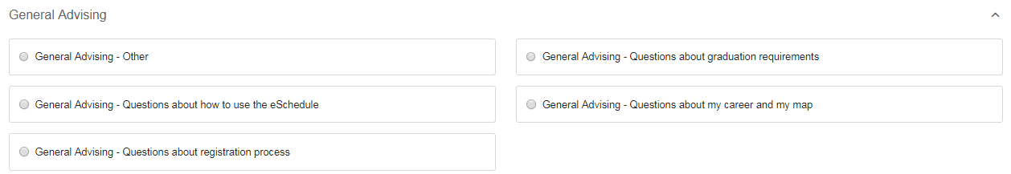
After you select a reason, you will be prompted to give a little more detail about what you need. Select the option that best fits you.

Slide 19
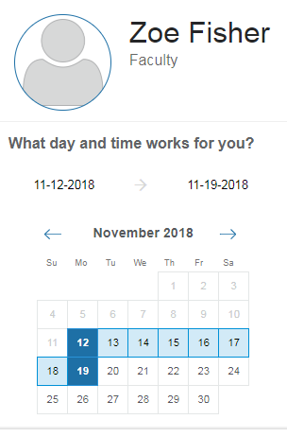
Next, enter a range of dates to view available appointments.

Slide 20
Next, enter a range of dates to view available appointments.
Type in or select a start and end date to see appointments available between these dates.

Slide 21
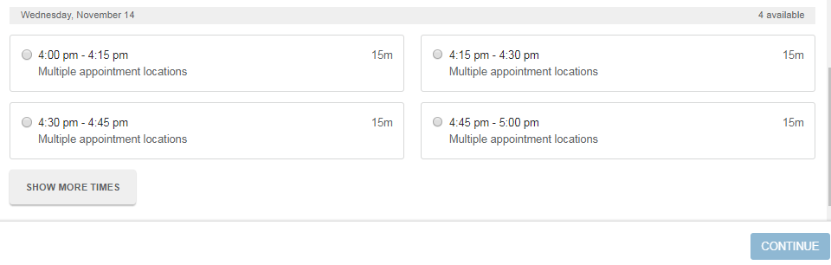
Click “Show More Times” to see more available options.

Slide 22
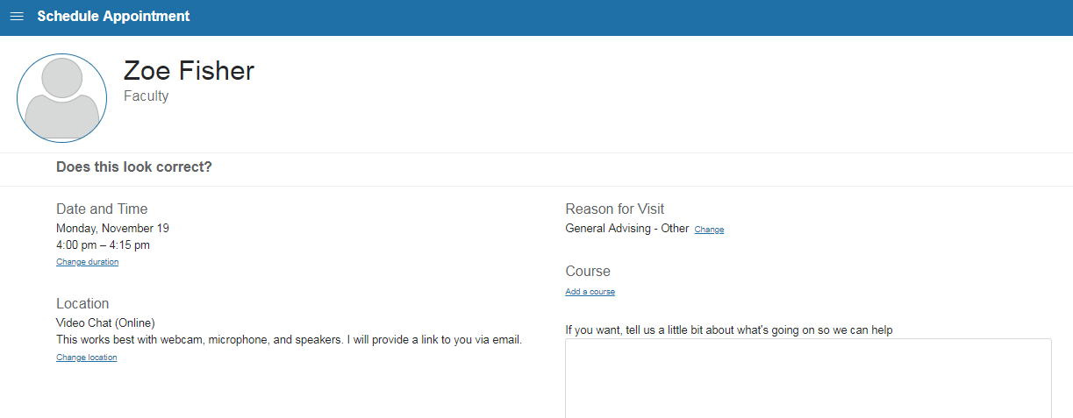
Use the pre-confirmation screen to double-check your appointment details.
You can also use this page to change the length or location of your appointment, if available.

Slide 23
Click “Change duration” to request a longer or shorter appointment length.
Click “Change location” to see more available options.

Slide 24
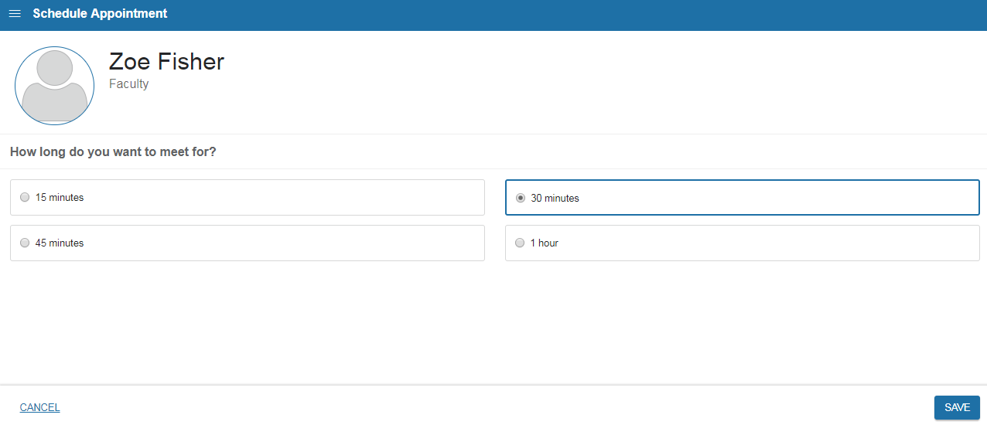
If longer or shorter appointments are available, you can change your appointment length.

Slide 25

If alternate locations are available, you can choose them here. In this example, you can choose a phone call instead of video chat.

Slide 26
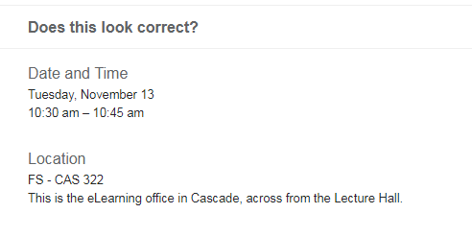
If no other options are available, you will not see “Change location” or “Change duration” – you’re all set!

Slide 27
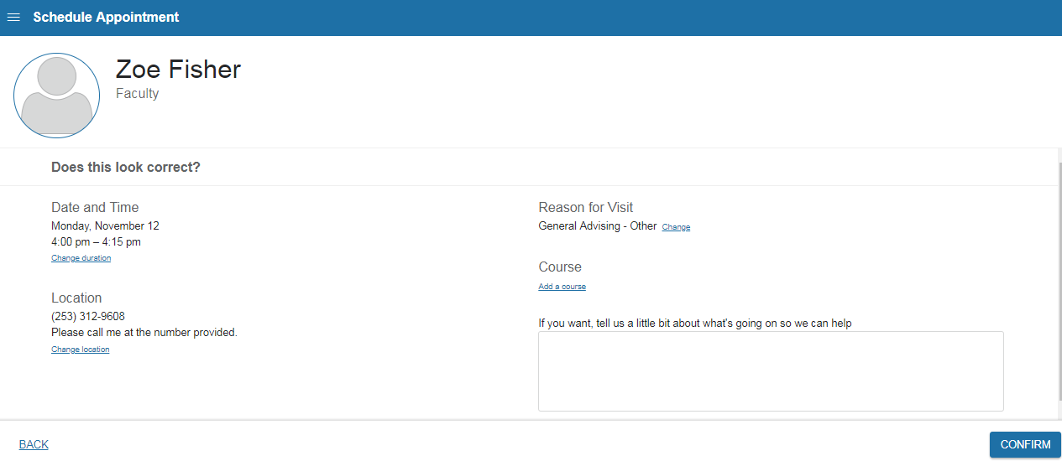
Use the text entry box to add any helpful information or details about your appointment request.

Slide 28
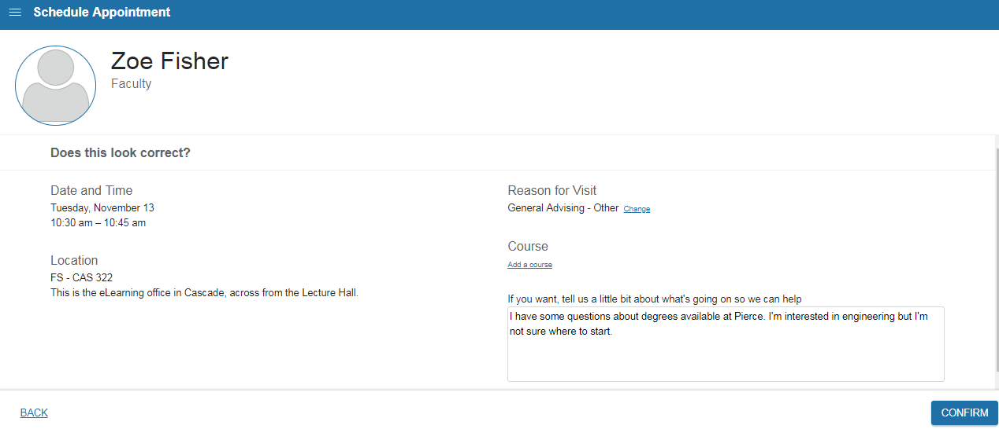
Double-check that everything looks good to you. When you’re ready, click Confirm to schedule your appointment.

Slide 29
That’s it!
You’ll get a message confirming your appointment.
You’ll also be notified via email if your appointment changes or is canceled.
Make sure that your email preferences and reminders are the way you want them to be. Check your profile for details.

Slide 30
Need help?
If you’re getting frustrated, or if Starfish isn’t working the way you expected, please email StarfishTeam@pierce.ctc.edu.
You can also contact
Tami Jacobs
Dean of Student Success & Starfish Implementation Lead
StarfishTeam@pierce.ctc.edu
(253) 964-6581

